Slide 1
Eco-friendly waste management
(SMART DUSTBIN)
GROUP MEMBERS:
1 RAJESH KHATUA
2 AVINASH KUMAR RAY
3 MOHANA KRISHNA
4 U.LOKESH
5 ASHISH KANTH
PROJECT INCHARGE
N.RAMULU

Slide 2
Contents
AIM OF THE PROJECT
BLOCK DIAGRAM
EXPLANATION OF COMPONENTS
PROTOTYPE OF THE PROJECT
RESULTS
FUTURE SCOPE
REFERENCE

Slide 3
Aim of the project
Waste segregation at the source is the most relevant step that will help the environment and helps to reduce the accumulation of garbage in landfills. Segregation post collection of garbage takes longer, costs more, and can wind up harming the environment if it leads to recyclable waste being sent to landfill.
Wet waste typically refers to organic waste usually generated by eating establishments and Dry waste includes paper, wood, metals, glass, etc. If 100% source segregation is achieved then 80% of it can be recycled.
To overcome this problem a smart dustbin can be used which would differentiate the waste into wet or dry and open up the required block of wet/dry section.It can even send an SMS whenever the dustbin reaches its maximum level.Which would finally help the environment and biodiversity.

Slide 4
Block diagram
POWER SUPPLY
ARDUINO UNO
Moisture sensor
Servo motor
Ultrasonic sensor
LCD
Ir sensor
LED

Slide 5
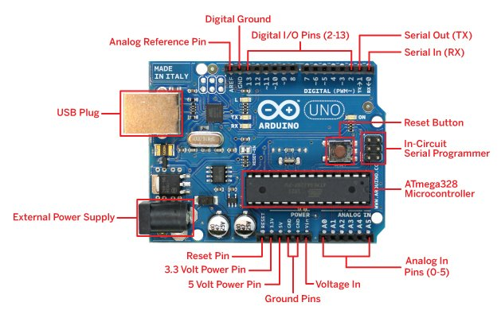
ARDUINO UNO
Arduino Uno is a microcontroller board based on the ATmega328P (datasheet). It has 14 digital input/output pins (of which 6 can be used as PWM outputs), 6 analog inputs, a 16 MHz ceramic resonator (CSTCE16M0V53-R0), a USB connection, a power jack, an ICSP header and a reset button.
Analog Input Pins: 6
Flash Memory: 32 KB (ATmega328P)
Length: 68.6 mm
Clock Speed: 16 MHz

Slide 6
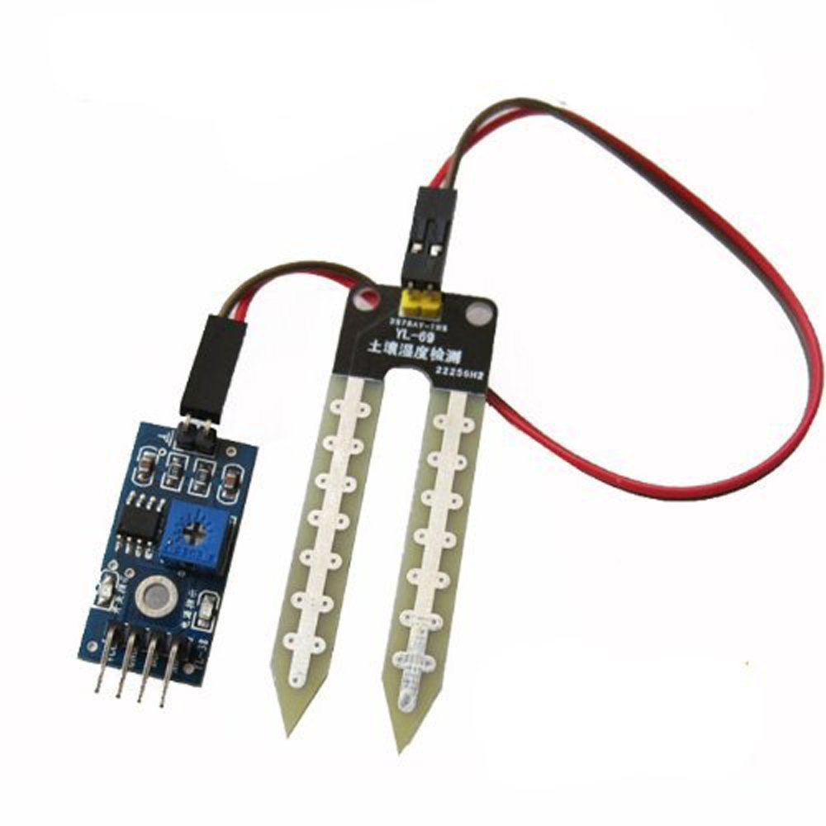
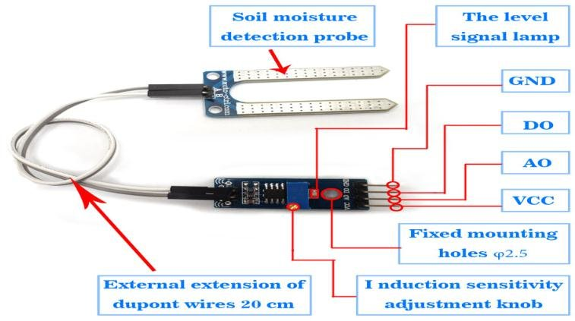
Moisture sensor
As the name indicates, this sensor is used to measure the moisture content in a given material. These sensors use the volumetric water content indirectly by making use of some other properties like electrical resistance, dielectric constant. In general cases, the sensor generates a voltage proportional to the dielectric permittivity and therefore measures the moisture content of a material
Technical Specifications
Parameter | Minimum | Typical | Maximum | Unit
Working voltage | 2.1 | 5 | 5.5 | VDC
Analog Output Voltage(VCC=5V) | 0 | Vout | 5 | V
The digital Output voltage(VCC=5V) | 0 | – | 5 | V
Working Current(VCC=5) | – | 5 | – | mA
Threshold Hysteresis(Uth) | – | VCC*0.09 | – | V

Slide 7
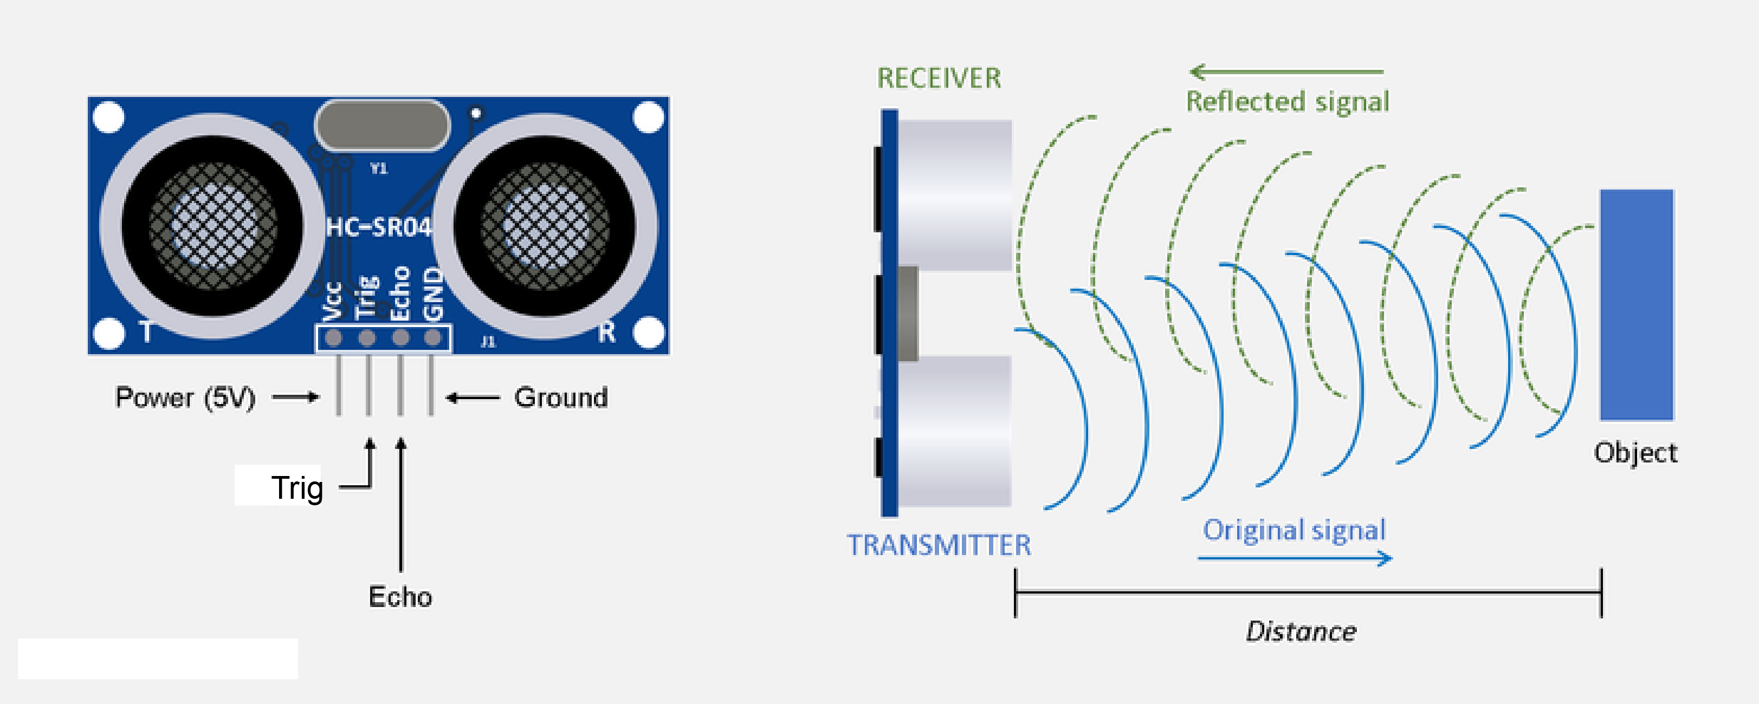
Ultra sonic sensor
Ultrasonic transducers and ultrasonic sensors are devices that generate or sense ultrasound energy. They can be divided into three broad categories: transmitters, receivers and transceivers. Transmitters convert electrical signals into ultrasound, receivers convert ultrasound into electrical signals, and transceivers can both transmit and receive ultrasound.
Systems typically use a transducer which generates sound waves in the ultrasonic range, above 18 kHz, by turning electrical energy into sound, then upon receiving the echo turn the sound waves into electrical energy which can be measured and displayed.

Slide 8
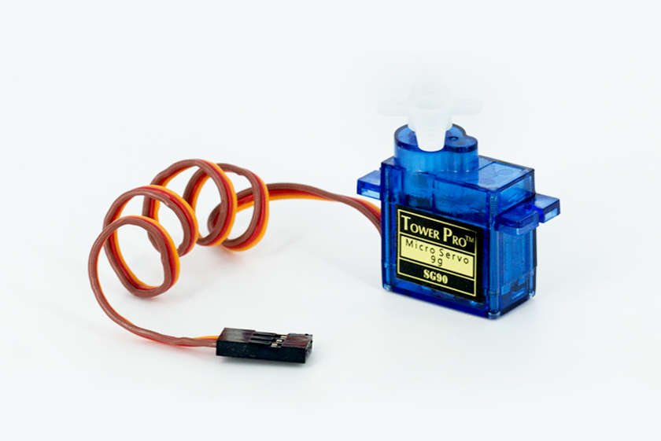
SERVO MOTOR
A servo motor is an electromechanical device that produces torque and velocity based on the supplied current and voltage. A servo motor works as part of a closed loop system providing torque and velocity as commanded from a servo controller utilizing a feedback device to close the loop.29-Sept-2020
This Photo by Unknown Author is licensed under CC BY-SA

Slide 9
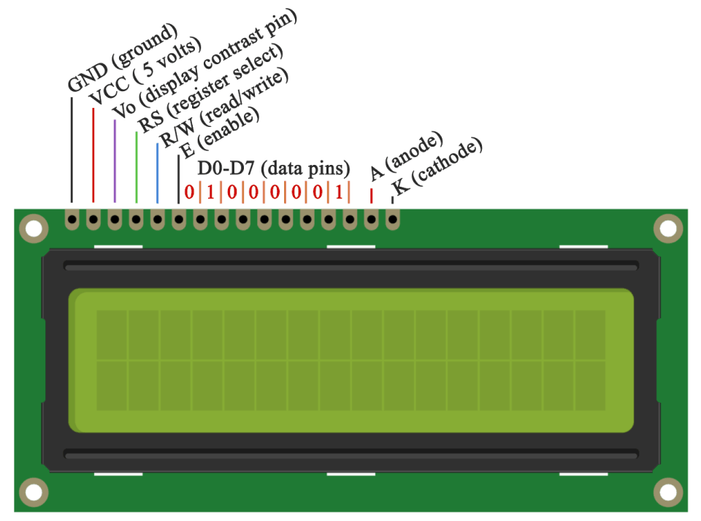
Liquid crystal display
This is a flat panel display that uses properties of liquid crystals. LCD displays do not emit light directly, instead, they use a backlight to develop images in single color. LCD displays are used in a wide range of applications like television panel, computer monitors and instrument panels as well. A 16 X 2 LCD means it can display16 characters per line and there are 2 such lines. In this display, each character is displayed using a 5×7 pixel matrix. This LCD has two pivotal registers that are:
Command Register: The command register stores the command given to the LCD by a micro-controller.
Data Register: The data register stores the data to be displayed on the LCD. The data that is displayed on the LCD screen, is actually the ASCII value of the characters that are to be displayed.

Slide 10
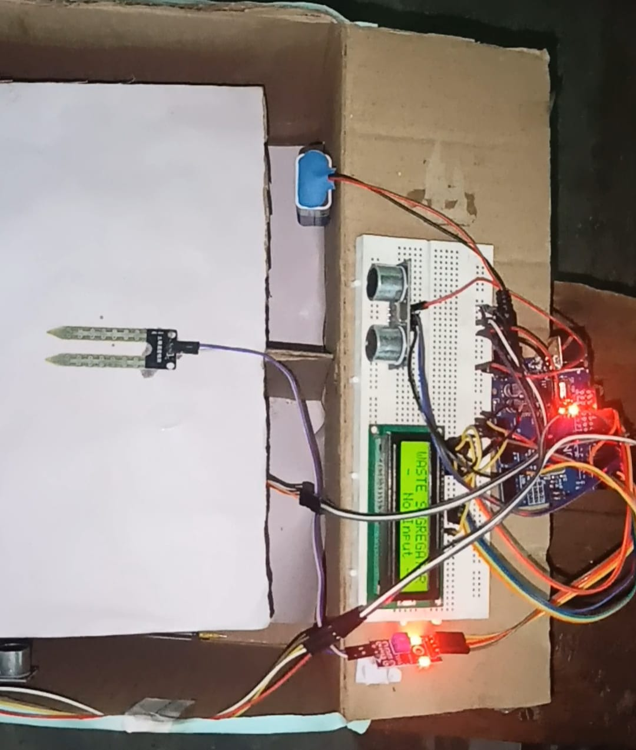
Prototype of the project

Slide 11

result
Our project helps to segregate wet and dry waste more efficiently and in a eco friendly manner without much efforts.
it reduces the amount of waste that reaches landfills, thereby taking up less space. Pollution of air and water can be considerably reduced when hazardous waste is separated and treated separately.

Slide 12
Future scope
This type of product can be used in housing societies, offices, etc. Since it is cost effective, it can be implemented on a large scale as well with some modifications. Using a robotic arm along with a conveyor belt will make the process of segregation easier. Also, more sensors can be used to segregate bio-degradable and non-bio-degradable waste, plastics, recyclable waste, e-waste, and medical waste.

Slide 13
refrences
The sites we used during our preparation of Documentation of project are as follows:
https://circuitdigest.com
https://en.wikipedia.org
https://www.arduino.com

Slide 14

Thank you

